Slide 1
Impact of Single Dose Praziquantel Treatment on Schistosoma haematobium Infection among School Children in an Endemic Nigerian Community
Babatunde Adewale1*, Margaret A. Mafe1,Medinat A. Sulyman1, Emmanuel T. Idowu2, Morakinyo B. Ajayi1David O. Akande1, James H. Mckerrow3, Emmanuel O. Balogun4

Slide 2
Introduction:
Schistosomiasis, also known as Bilharzia, is a disease caused by parasitic worms that lives in certain types of freshwater snails.
Infection can occur when consuming contaminated freshwater.
Serious threat to public health.
Co-factor in the transmission of HIV.
Notes:
1-
2- parasite can penetrate through skin.
3- Schistosomiasis is a serious public health problem that faces the world generally, and Nigeria specifically.
4- 250 million people worldwide are infected, and 11,700 ppl die annually.
5- infected females are at a huge risk of spreading HIV

Slide 3
Main goals:
Effectiveness of Praziquantel drug against Schistosomiasis in a Nigerian community.
Examine the possibility of developing resistance against the drug.
Notes:
1- “Praziquantel” is considered a great and cheap alternative to chemotherapy that coast a lot, and has a lot of side-effects.
2- control programs in China, Egypt, Brazil, Philipines, Japan and Uganda using Praziquantel were successful

Slide 4
Methods:
Location: Ipogun, Ondo Nigeria.
Sample size: n=434 children, 244 males, and 190 females.
Study type: longitudinal study, over 12 months.
Study design: schoolchildren aged (5-18).
  Urine samples collected, examined, & recorded.
  Participants were given a single oral dose of Praziquantel.
  2 more samples collected at 6, and 12 months post treatment.
Notes:
1- The study was conducted in a small village in Ondo, Nigeria within a small community called Ipogun, which were mainly farmers, and they use river, and wells as water source.
2- study design included children aged (5-18), whom are enrolled in a study school, at 4 different schools, 1 private school, and 3 public schools,
3- The researchers collected urine samples, and labeled them according to age, sex, school code, class code, and serial number. Afterwards, each sample was examined for the presence of Schistosoma’s eggs within about 10-14 hour, and then recorded.
4- Praziquantel dose of 40 mg per kg of body weight.

Slide 5
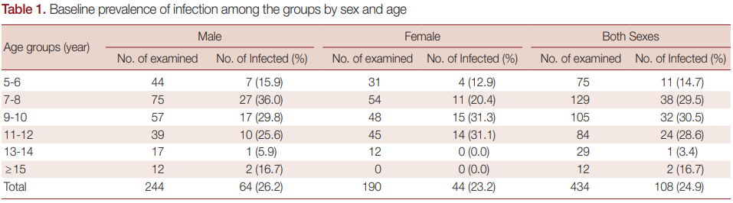
Results:
Notes:
1- The results of this study show that, before the treatment, the egg prevalence in the samples was about 25%, with no significant difference in infection rate between males and females, (Males 14.7%; Females 10.2%).
2- also, age group of 9-10 showed more infection prevalence, followed by age group 7-8, and the lowest prevalence of age group was 13-14 years old.

Slide 6
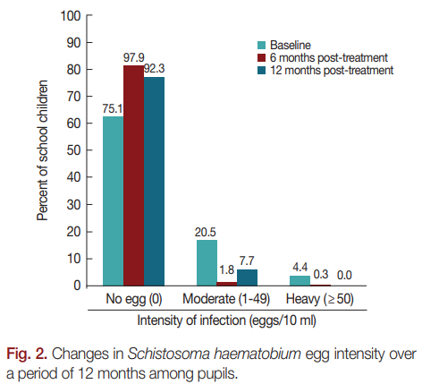
Notes:
1- After six months of treatment, the infection prevalence dropped to 2.1% , which means that the reduction rate is 91.6%.
2- after the 12 months, the infection rate increased to 7.7% which means reduction rate of 69.1% compared to baseline.

Slide 7
Conclusions:
younger age group are more likely to be infected with Schistosomiasis.
Private school shows the lowest infection rate.
Results shows that Praziquantel seems to be significantly effective within 6 months of treatment.
After 12 months, slight increase in the infection rate.
Notes:
1- aged between (9-10).
2- mainly because of their economical status.

Slide 8
Implications:
Main habits of the community, are the reason of the increase in infection rate.
Educate these communities about getting water from a clean and safe sources.
Continue using Praziquantel.

Slide 9
Limitations:
Sample size shows low infection rate (25%).
Weather, and season influences the infection rate.
Notes:
Infection rate are highly during dry seasons

Slide 10
Future directions:
The slight increase in the infection rate, significantly implies that we need to constantly treat every year for achievement of elimination by the end of year 2020.
Need for continuous efforts at monitoring the disease transmission and treatment.
Need for control measures, such as snail control and health education.

Slide 11
Why choose this topic ?
Because this disease is considered as “Neglected tropical diseases (NTDs).”
Notes:
1- are a group of parasitic and bacterial diseases that cause illness for more than one billion people globally.
2- it Affects the world’s poorest people.
3- causes child illness and death.
4- and it traps the poor in a cycle of poverty and disease.

